Slide 1




Randomness in Computing
LECTURE 10
Last time
Chernoff Bounds
Today
Hoeffding Bounds
Applications of Chernoff-Hoeffding Bounds
Estimating a Parameter
Set Balancing
CS
537
Sofya Raskhodnikova;Randomness in Computing

Slide 2
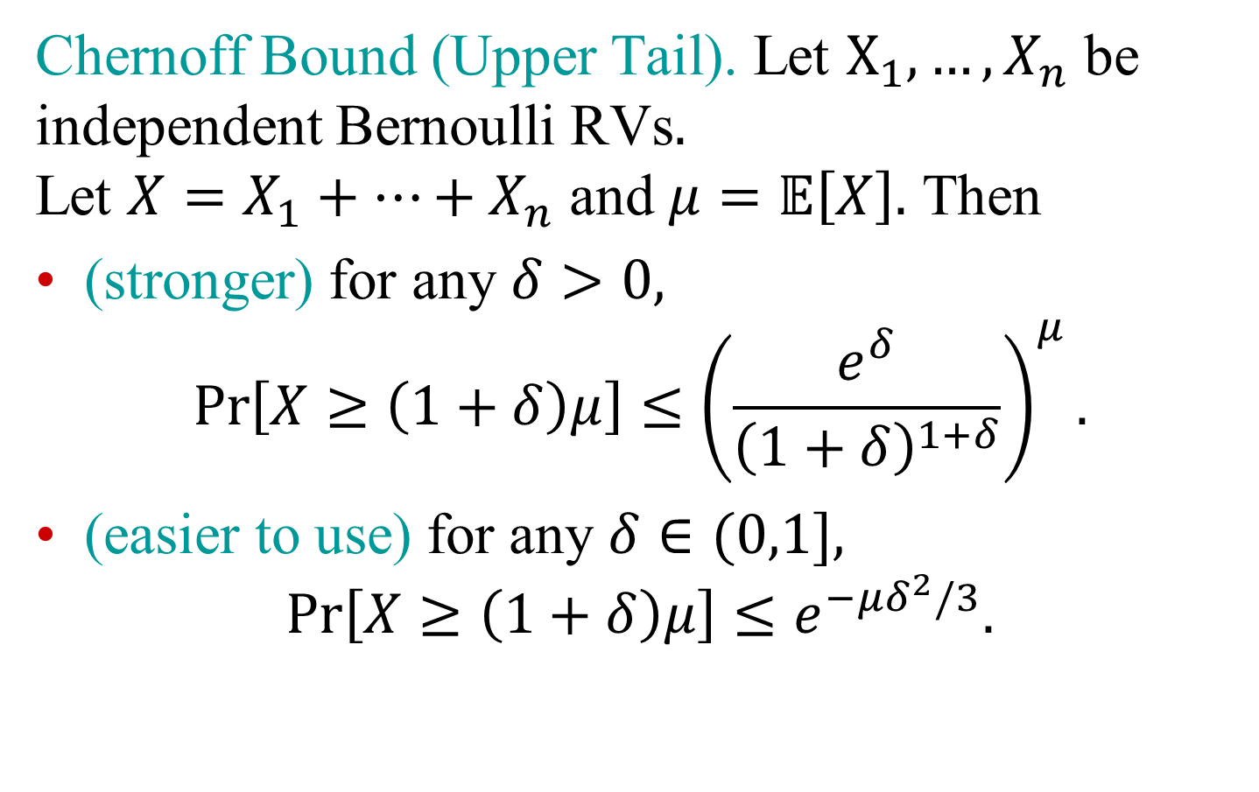
Sums of independent RVs
Chernoff Bound (Upper Tail). Let $X_{1},…, X_{n}$ be independent Bernoulli RVs$.$ Let $X=X_{1}+…+X_{n}$ and $μ=𝔼\left[X\right].$ Then
(stronger) for any $δ>0,$
$$\operatorname{Pr}\left[X≥\left(1+δ\right)μ\right]≤{\left(\frac{e^{δ}}{{\left(1+δ\right)}^{1+δ}}\right)}^{μ}.$$
(easier to use) for any $δ∈(0,1],$
$$\operatorname{Pr}\left[X≥\left(1+δ\right)μ\right]≤e^{−μδ^{2}/3}.$$

Slide 3
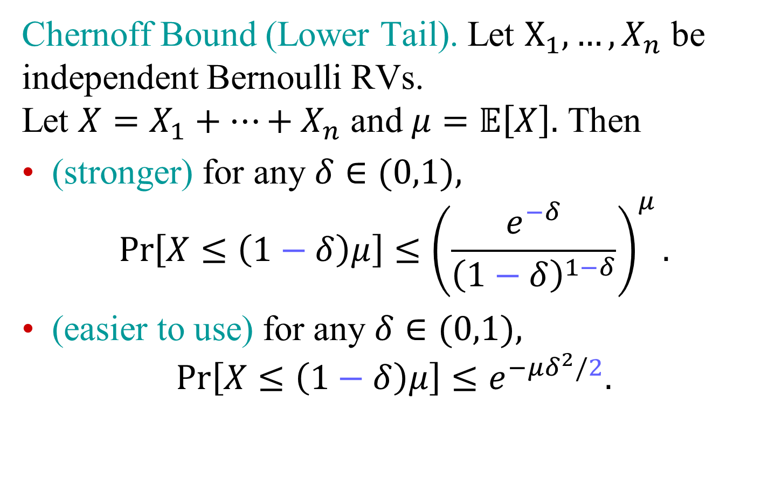
Sums of independent RVs
Chernoff Bound (Lower Tail). Let $X_{1},…, X_{n}$ be independent Bernoulli RVs. Let $X=X_{1}+…+X_{n}$ and $μ=𝔼\left[X\right].$ Then
(stronger) for any $δ∈(0,1),$
$$\operatorname{Pr}\left[X≤\left(1−δ\right)μ\right]≤{\left(\frac{e^{−δ}}{{\left(1−δ\right)}^{1−δ}}\right)}^{μ}.$$
(easier to use) for any $δ∈(0,1),$
$$\operatorname{Pr}\left[X≤\left(1−δ\right)μ\right]≤e^{−μδ^{2}/2}.$$

Slide 4
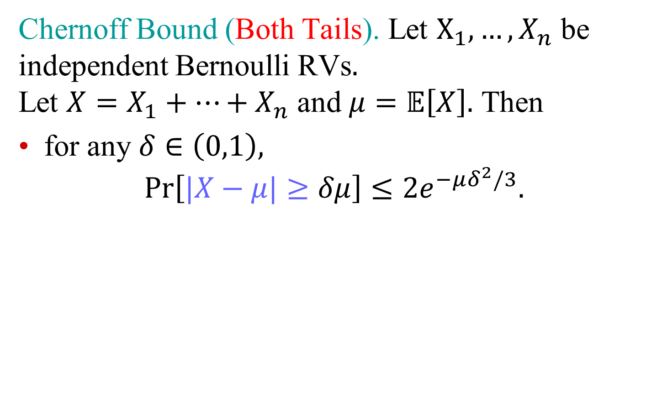
Sums of independent RVs
Chernoff Bound (Both Tails). Let $X_{1},…, X_{n}$ be independent Bernoulli RVs$.$ Let $X=X_{1}+…+X_{n}$ and $μ=𝔼\left[X\right].$ Then
for any $δ∈\left(0,1\right),$
$$\operatorname{Pr}\left[|X−μ|≥δμ\right]≤{2e}^{−μδ^{2}/3}.$$

Slide 5
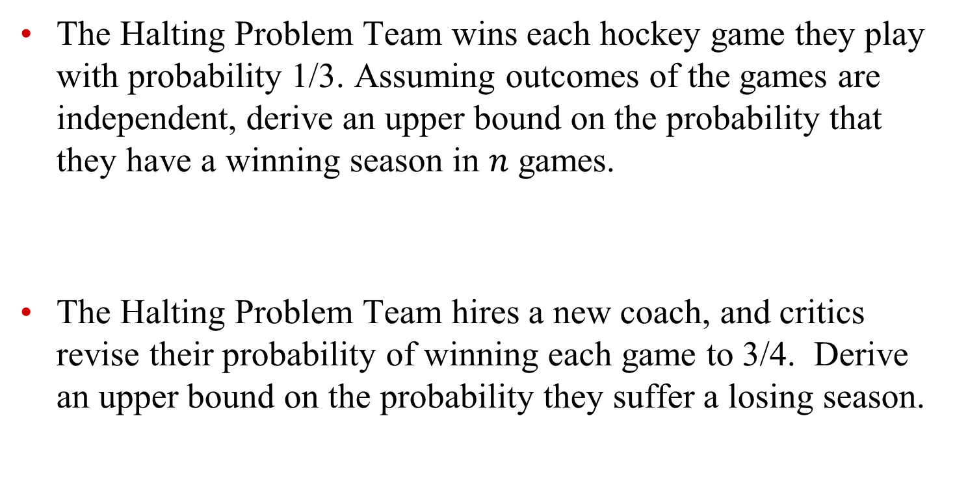
Exercise 2
The Halting Problem Team wins each hockey game they play with probability 1/3. Assuming outcomes of the games are independent, derive an upper bound on the probability that they have a winning season in $n$ games.
The Halting Problem Team hires a new coach, and critics revise their probability of winning each game to 3/4. Derive an upper bound on the probability they suffer a losing season.
Notes:
5/2

Slide 6
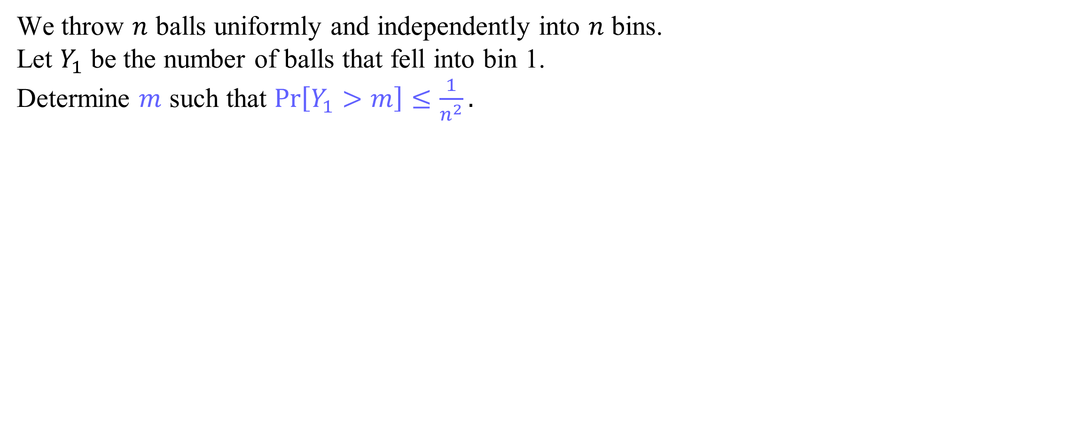
Exercise 3
We throw $n$ balls uniformly and independently into $n$ bins. Let $Y_{1}$ be the number of balls that fell into bin 1. Determine $m$ such that $\operatorname{Pr}\left[Y_{1}>m\right]≤\frac{1}{n^{2}}.$

Slide 7
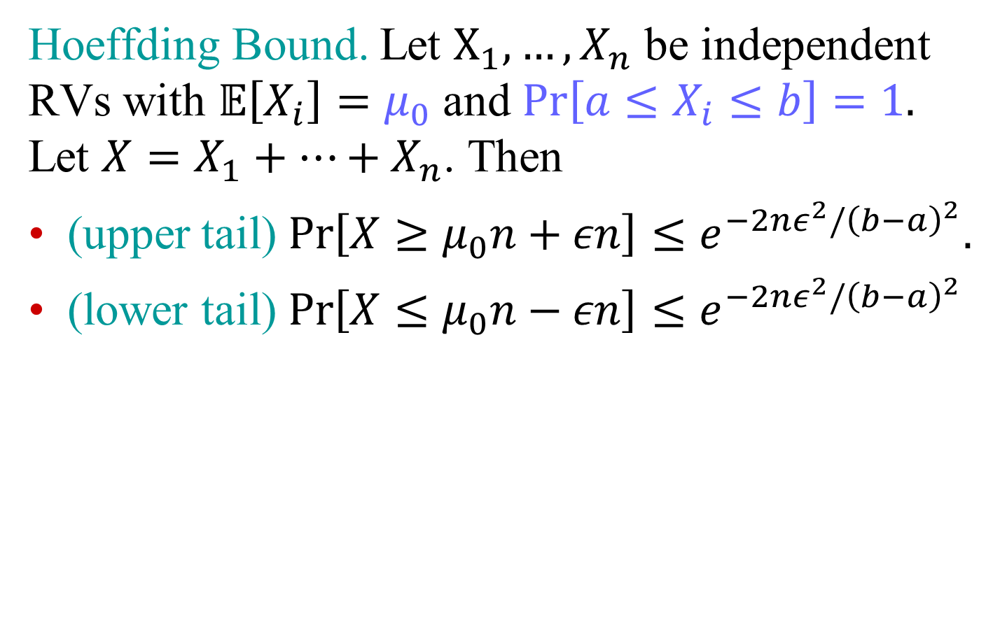
Sums of independent RVs
Hoeffding Bound. Let $X_{1},…, X_{n}$ be independent RVs with $𝔼\left[X_{i}\right]=μ_{0}$ and $\operatorname{Pr}\left[a≤X_{i}≤b\right]=1.$ Let $X=X_{1}+…+X_{n}$. Then
(upper tail) $\operatorname{Pr}\left[X≥μ_{0}n+εn\right]≤e^{−2nε^{2}/{\left(b−a\right)}^{2}}.$
(lower tail) $\operatorname{Pr}\left[X≤μ_{0}n−εn\right]≤e^{−2nε^{2}/{\left(b−a\right)}^{2}}$

Slide 8
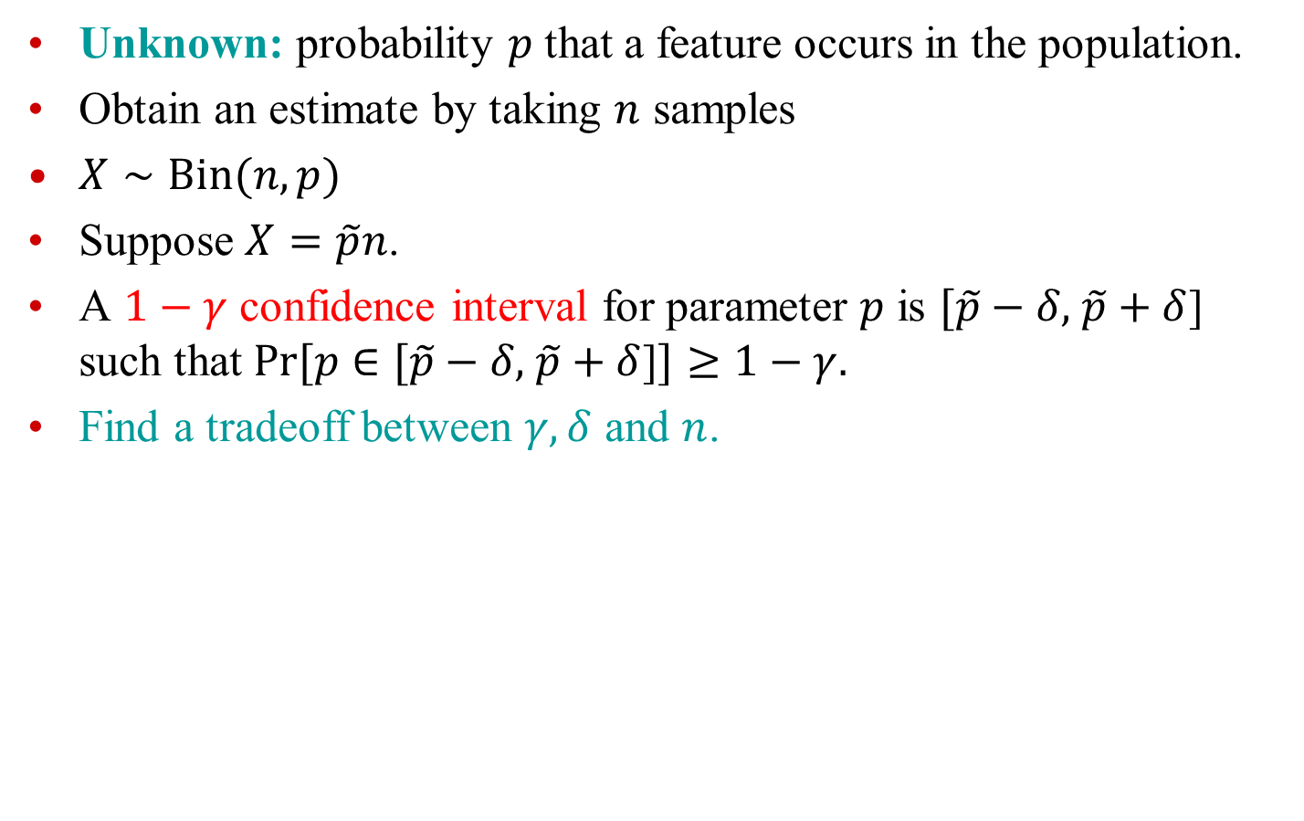
Application: Estimating a parameter
Unknown: probability $p$ that a feature occurs in the population.
Obtain an estimate by taking $n$ samples
$X∼Bin(n,p)$
Suppose $X=\tilde{p}n$.
A $1−γ$ confidence interval for parameter $p$ is $[\tilde{p}−δ,$ $\tilde{p}+δ$] such that $Pr⁡[p∈$ $[\tilde{p}−δ,$ $\tilde{p}+δ$]$]≥1−γ.$
Find a tradeoff between $γ, δ$ and $n$.

Slide 9
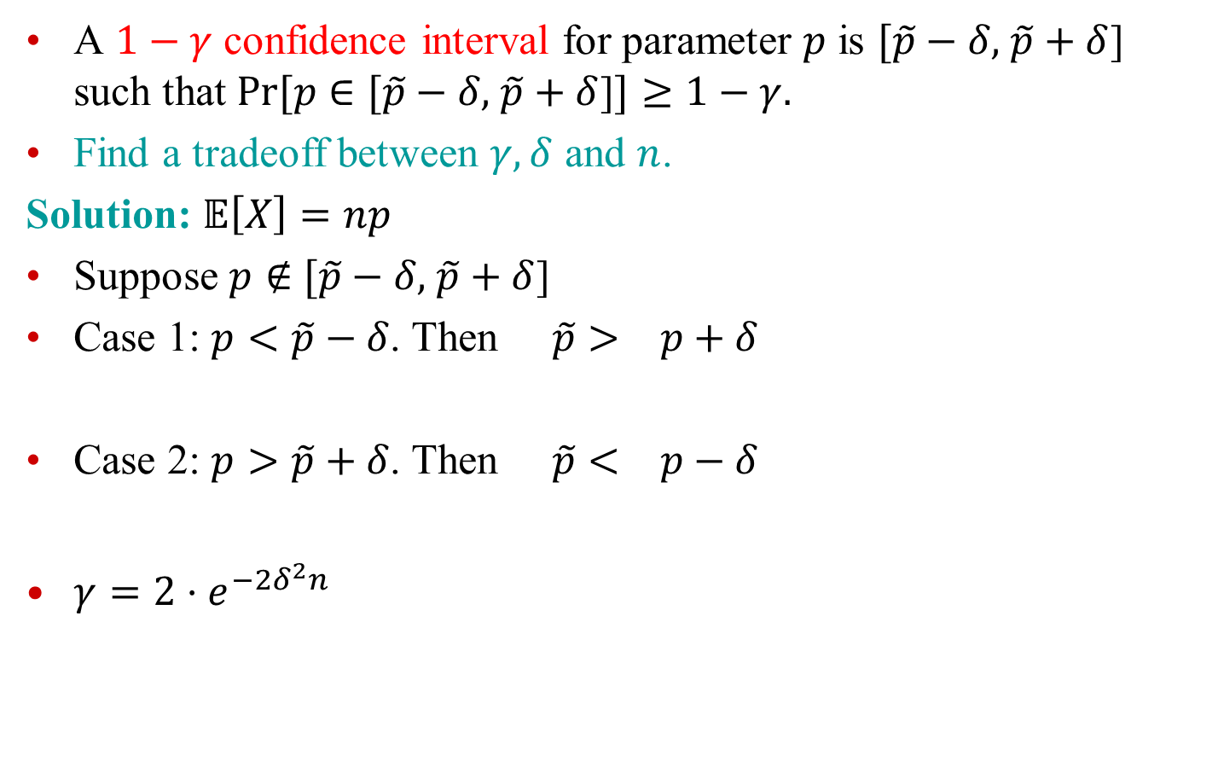
Application: Estimating a parameter
A $1−γ$ confidence interval for parameter $p$ is $[\tilde{p}−δ,$ $\tilde{p}+δ$] such that $Pr⁡[p∈$ $[\tilde{p}−δ,$ $\tilde{p}+δ$]$]≥1−γ.$
Find a tradeoff between $γ, δ$ and $n$.
Solution: $𝔼\left[X\right]=np$
Suppose $p∉$ $[\tilde{p}−δ,$ $\tilde{p}+δ$]
Case 1: $p<\tilde{p}−δ$. Then $\tilde{p}> p+δ$
Case 2: $p>\tilde{p}+δ$. Then $\tilde{p}< p−δ$
$γ=2⋅e^{−2δ^{2}n}$

Slide 10

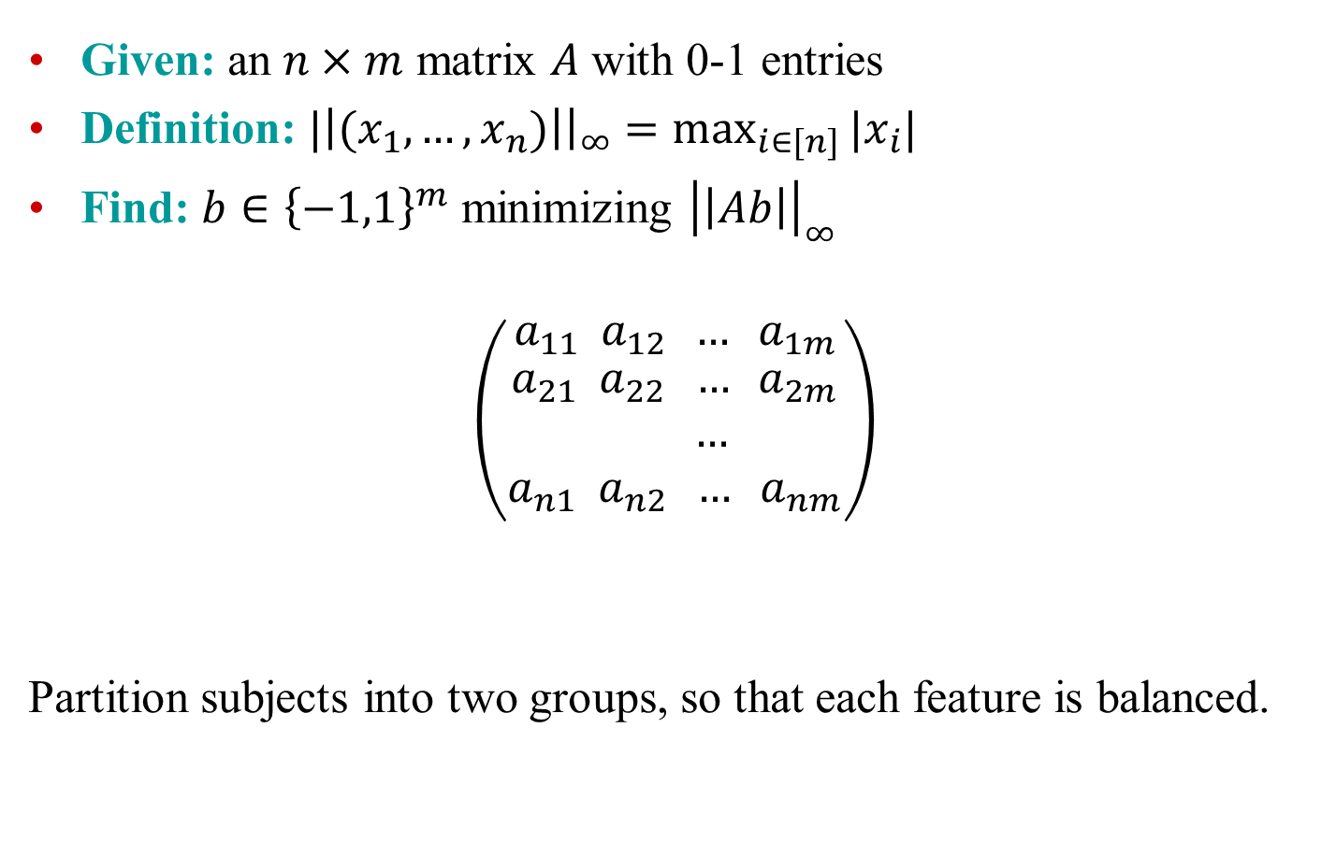

Application: Set Balancing
Given: an $n×m$ matrix $A$ with 0-1 entries
Definition: $|\left|(x_{1},…,x_{n})\right|{\left.​\right|}_{∞}=\max_{i∈[n]}{|x_{i}|}$
Find: $b∈{\left\{−1,1\right\}}^{m}$ minimizing ${\left|\left|Ab\right|\right|}_{∞}$
$$\left({a_{11} a_{12} … a_{1m} \atop \begin{aligned}a_{21} a_{22} … a_{2m} \\ … \\ a_{n1} a_{n2} … a_{nm}\end{aligned}}\right)$$
Partition subjects into two groups, so that each feature is balanced.
$n$ features
$m$subjects

